Slide 1
Computer Science Week 10: dRONES!

Slide 2
LESSON SUMMARY – The BIG Picture
Binary Numbers+ ✔️
Algorithms ✔️
How does the Internet work? ✔️
Scratch – Animate your name ✔️
Scratch - Make it fly ✔️
Scratch - Make it fly (part 2) ✔️
Scratch - Create a virtual pet(part1) ✔️
Scratch - Create a virtual pet(123) ✔️
Scratch - Conan the Librarian ✔️
Drones and more!
Notes:
Beyond Scratch (Python + Java)
Embedded Computers (Arduino)

Slide 3
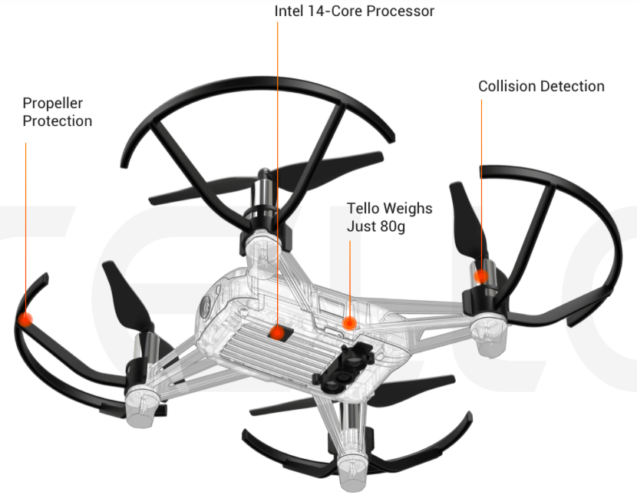
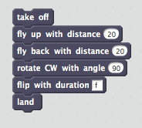
Technological INNOVATION
Innovation —a new or improved idea, device, product, etc. Recognizing a problem that needs to be solved, or recognizing something needs improving and then building a tool to solve it.
Example – Drones also known as UAVs (Unmanned Aerial Vehicles).
For Disaster Relief, sent in to assess extent of structural damage using aerial photography, delivering emergency supplies, etc. where manned flight is considered too risky or difficult.
Notes:
….is about recognizing a problem that needs to be solved, or recognizing something needs improving and then building a tool to solve it.
Disaster Relief- Send drones in to assess damage. Disaster In March 2011, a powerful earthquake caused a tsunami to hit Japan, resulting in severe damage to the Fukushima Daiichi nuclear plant. The damage led to a full-scale evacuation because of the amount of dangerous nuclear material that was released. Drones were deployed in the air and on the ground at the first possible instance to assess the extent of the destruction.
The area is largely inaccessible due to damaged roadways and bridges, but drone footage shows a startling bird's-eye glimpse of the destruction Michael caused when it made landfall near Mexico Beach
What are some other examples?? Everyday examples….making information more accessible, the Internet. Being able to communicate while traveling or while moving – the mobile/cell phone.
For you own area of interest:
1. Identify some way that technology is used with, or affects that thing
2. Can you make a suggestion for either: i) a way that technology might be improved to make it better, faster, easier to use ii) a creative or innovative new technology might help solve some problem within that area, or at least make better?
Be on the lookout, to be alert, for where and how computer science & technology affects or impacts the things you care about, the things you know a lot about. Whatever it is you want to do in your life, it’s pretty likely that technology affects it in some way, or that some technological innovation is called for.

Slide 4
DRONES!
Today's project involves learning a bit about Drones
What are drones used for?
Going where it's dangerous for humans
Taking pictures
Learning

Slide 5
First, some vocab
Yaw:
If you were looking down on a drone from above, yaw refers to the movement of the drone clockwise or counterclockwise.
Pitch:
Simply describes movement up and down along the vertical axis from the front to the back of the drone.
Roll:
The rotation of the aircraft from front to back on a copter.
Basically it refers to the movement of the drone forward, backward, left and right along a horizontal axis.
Quadcopter: a drone with 4 rotors
Notes:
Drone terms taken from https://airdronecraze.com/quick-reference-guide-of-drone-terminology/

Slide 6
How do we talk to A DRONE?
The drone we are using is called a "Tello"
It creates a wifi network that we attach to
We can then use a computer to connect to that network to control the drone.
On the computer, we need to use a special software that is a "plugin" to Chrome called "DroneBlocks"
Notes:
DroneBlocks is a free download and available in the iOS App Store, Google Play Store, and Chrome App Store.

Slide 7
First we need to take off!
What if we had a drone take off and then fly in a square?
What would our program look like?
Takeoff
Fly straight
Turn right
Fly straight
Turn right
Fly straight
Turn right
Fly straight
Land!

Slide 8
SQUARE DANCING
In DroneBlocks, your program is called a MISSION.
You write your program just like in Scratch, and then connect to the Tello drone, and tell it to execute the mission.
Let's try the 'fly a square' mission first.

Slide 9
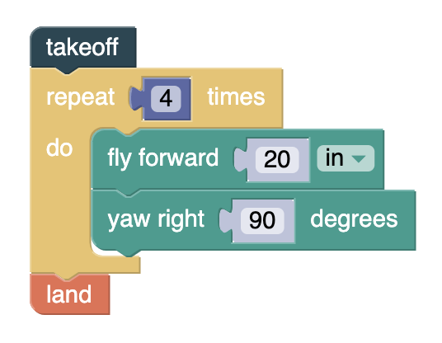
SQUARE DANCING
The Mission…
Takeoff
Yaw left 45°
Flip 3 times
Land!
Wild Applause!

Slide 10
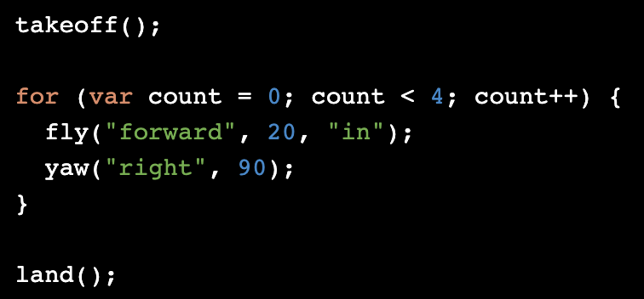
SQUARE DANCING
Guess what? You can also VIEW THE code…

Slide 11
SQUARE DANCING (Code)
This is written in DroneBlocks
(like Scratch)
This is written in JavaScript !

Slide 12
More complicated
Take off, turn left, do 3 flips, then land
Hint: use a loop!
What would our program look like?
Takeoff
Yaw left 45°
Flip 3 times
Land!

Slide 13
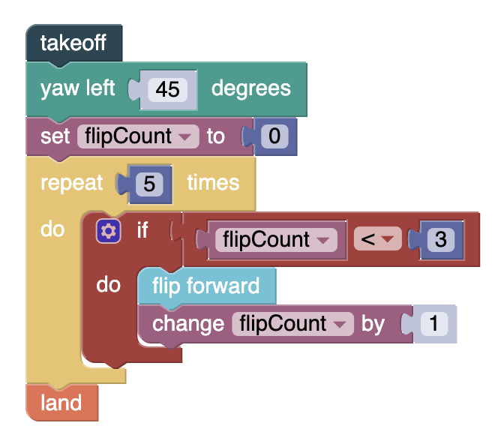
More complicated
Do you want to try and write it out first?
The Mission…
Takeoff
Yaw left 45°
Flip 3 times
Land!
Wild Applause!

Slide 14
To Infinity... & Beyond!
What we can do 'manually' ?
DroneBlocks doesn't support these yet:
Throw and Go
Bounce
Land on your hand!
Flips
Take pictures
Take videos

Slide 15
BASIC FLIGHT DEMO
I'm going to do a quick demo, using my iPhone on the projector screen.
Takeoff
Turning (also called what?)
Moving
Landing

Slide 16
More features
Throw and Go
Bounce mode
Land on your hand
Flips
Take Picture
Take Video

Slide 17
SHARING THE DRONES
Each drone flight needs THREE people
Pilot (person holding the iPhone / iPad)
Co-Pilot (person watching the flight)
Search & Rescue (person to follow drone!)
Rules of flight:
Stay away from other drones!
You may take pictures
Land as soon as "SWITCH" is called!

Slide 18
WRAP-UP
Your Scratch accounts are YOURS, please continue to use them to expand your programming skills!
I will add some other projects into the shared Studio as samples to play with.
All Remixes have comments waiting for you!

Slide 19
WE DID IT!
Binary Numbers+ ✔️
Algorithms ✔️
How does the Internet work? ✔️
Scratch – Animate your name ✔️
Scratch - Make it fly ✔️
Scratch - Make it fly (part 2) ✔️
Scratch - Create a virtual pet(part1) ✔️
Scratch - Create a virtual pet(123) ✔️
Scratch - Conan the Librarian ✔️
Drones and more! ✔️

