Slide 1
Computer Science Week 4: CODING! SCRATCH: Animate Your Name
Bill Mitchell
RESET Program Volunteer Teacher

Slide 2
LESSON SUMMARY – The BIG Picture
Binary Numbers+ ✔️
Algorithms ✔️
How does the Internet work? ✔️
Scratch – Animate your name
Scratch - Make it fly
Scratch - Create a virtual pet
Scratch - Conan the Librarian
Beyond Scratch (Python + Java)
Embedded Computers (Arduino)
Drones – introduction (part 1)
Drones – flight path (part 2)
SPECIAL PROJECT

Slide 3
POSITIVITY PROJECT
What is the Positivity Project goal is for the week?
Why would this be important to a programmer?
Software Licenses
Open Source Code
Intellectual integrity
Come up with your own solutions
Let's practice that as we work in groups today!
Notes:
NOTE: This week's theme is INTEGRITY – You are honest and speak the truth. You present yourself genuinely and sincerely.
Xref https://posproject.org/character-strengths/
Xref: https://posproject.org/resources/
Xref: https://docs.google.com/document/d/1E0_m833_jnQyrdU-VhzBOtwB-o3XsT4D9ljjRUi70aM/edit
Don't STEAL code!
Open Source Code – give credit where credit is due
Intellectual integrity
Come up with your own solutions

Slide 4
CS Lesson 4: MAKE Your Name
Today's class is going to be MOSTLY coding but I still need your attention.
We will do the first part TOGETHER (so that we all have our name to start with)
Once you get the basics done, you have FLEXIBILITY to experiment, and make your own project unique to yourself.
I'm excited to see what you come up with!
Notes:
This lesson is based on https://curriculum.code.org/csf-19/coursef/14/

Slide 5
STEP 1: Make your name!
OVERVIEW of what we're going to do..
Start a new Scratch project
Go to https://scratch.mit.edu/projects/editor
Pick a background
Optional: get rid of the cat
Add new Sprites for each letter of your name, and position them on the screen.

Slide 6
Blank Canvas!

Slide 7
Background & No Cat!
I'm ALLERGIC!

Slide 8
LOTS OF backgrounds!

Slide 9
I picked the BoardwalK…

Slide 10
Now add each letter

Slide 11
Lots to choose from..

Slide 12
Pick a letter, any letter!

Slide 13
Let it 'B', Let it 'B' !! 🎵🎶

Slide 14
What did we just do?
Each letter you placed on the screen is called a SPRITE
The cat was a sprite too.
You can attach code, costumes, and sounds to sprites and backgrounds in Scratch.
A Sprite is an object that you can program and then reuse.
Why do you think that this would be useful?

Slide 15
How can we spruce this up?
What are some things that we can do to make the letters more interesting ?
Colour
Sound!
Motion!
Size
Rotation
Costume
Bouncing
Speech bubbles
Music
AND TONS MORE!!

Slide 16
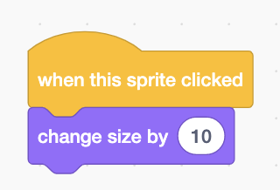
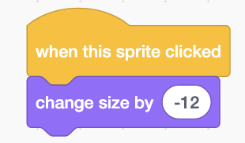
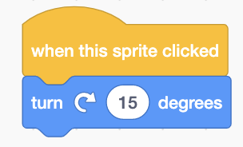
Customize EACH letter
So your job now is to click on each letter and make it do something fun!
You could make it GROW
You could make it SHRINK
You could have it turn!

Slide 17
CS Lesson 4: Animate Your Name
http://bit.ly/32lqQHT
Here's some URLs to go to which have some inspiration and tips on other ways to make it even more exciting!
https://vimeo.com/111342687 (1 minute)
https://csfirst.withgoogle.com/c/cs-first/en/animate-a-name/animate-a-name/animate-a-name.html (2:38)
http://bit.ly/32lqQHT
Remember, the code you attach to a Sprite can be dragged onto another Sprite if you want to experiment!
Notes:
This lesson is based on https://curriculum.code.org/csf-19/coursef/14/

Slide 18
IF YOU FINISH THIS
If you have succeeded in animating your name, you have met the goal for this week
Remember what the Positivity Project goal was at the beginning
HELP the person next to you, make sure your entire table has their name moving!

Slide 19
Who wants a challenge?
If the teachers can post this link on the school's website, here's a set of exercises that would be good to try and tackle.
https://studio.code.org/s/coursef-2019/stage/15/puzzle/1
This set of exercises will test your ability to READ code as well as write code.

Slide 20
Look before you leap!
One of the first mistakes that new programmers make is assuming that they have to create EVERYTHING themselves.
When you run into a problem, how many other people have run into it before?
Sometimes it's better to build your own version (for example, for learning, like today!)
…and sometimes you can and should start from the work of others.
Just like when we discussed algorithms!

Slide 21
WRAP-UP
Today was our first class where we had to work mostly independently in programming.
If you get behind, DO NOT PANIC!
if you finish early, try to help the person next to you.
A good programmer helps their neighbour!
If you have questions about today's topic, please bring them next week so that we can go over them!

Slide 22
NEXT WEEK….
Binary Numbers+
Algorithms
How does the Internet work?
Scratch – Animate your name
Scratch - Make it fly ←
Scratch - Create a virtual pet
Scratch - Conan the Librarian
Beyond Scratch (Python + Java)
Embedded Computers (Arduino)
Drones – introduction (part 1)
Drones –flight path (part 2)
SPECIAL PROJECT

