Slide 1
Computer Science Week 3: INTERNET
Bill Mitchell
RESET Program Volunteer Teacher

Slide 2
LESSON SUMMARY – The BIG Picture
Binary Numbers+ ✔️
Algorithms ✔️
How does the Internet work?
Scratch – Animate your name
Scratch - Make it fly
Scratch - Create a virtual pet
Scratch - Conan the Librarian
Beyond Scratch (Python + Java)
Embedded Computers (Arduino)
Drones – introduction (part 1)
Drones – flight path (part 2)
SPECIAL PROJECT

Slide 3
POSITIVITY PROJECT
What is the Positivity Project goal is for the week?
Why would this be important to a programmer?
Individual work vs. Team Work
Distracted Focus = Less Efficient
You miss something, you get lost!
Let's practice that as we work in groups today!
Be Present
When you're with other people, you are present and you give them your full attention.
Notes:
NOTE: This week's theme is (OPM2) Being present and giving others my attention
Xref https://posproject.org/character-strengths/
Xref: https://posproject.org/resources/
Xref: https://docs.google.com/document/d/1E0_m833_jnQyrdU-VhzBOtwB-o3XsT4D9ljjRUi70aM/edit
The greatest favor you can do to your sister, mother, [] professor, student, is put away your phone.
-Sherry Turkle
https://posproject.org/blog-week-26-opm2-be-present/

Slide 4
CS Lesson 3: INTERNET VOCAB
Internet
A group of computers and servers that are connected to each other
Wi-Fi
A wireless method of sending information using radio waves
Fiber Optic Cable - Say it with me: Fye-ber Op-tic Cay-bl
A connection that uses light to transmit information
DSL/Cable
A method of sending information using telephone or television cables
Servers
Computers that exist only to provide things to others
URL (Universal Resource Locator)
An easy-to-remember address for calling a web page (like www.code.org)
IP Address
A number assigned to any item that is connected to the Internet
DNS (Domain Name Service)
The service that translates URLs to IP addresses
Packets
Small chunks of information that have been carefully formed from larger chunks of information
Notes:
This lesson is based on https://curriculum.code.org/csf-19/coursef/14/

Slide 5
The inter-what?
What is an "internet"?
Two computers = the smallest network
An "INTER-connected NETwork"
A second network…
So just imagine this…
With about few billion more computers!

Slide 6
A Brief History
Notes:
History of the internet image credit: http://lydiavportfolio.weebly.com/uploads/2/6/4/3/26433387/9489394_orig.png

Slide 7
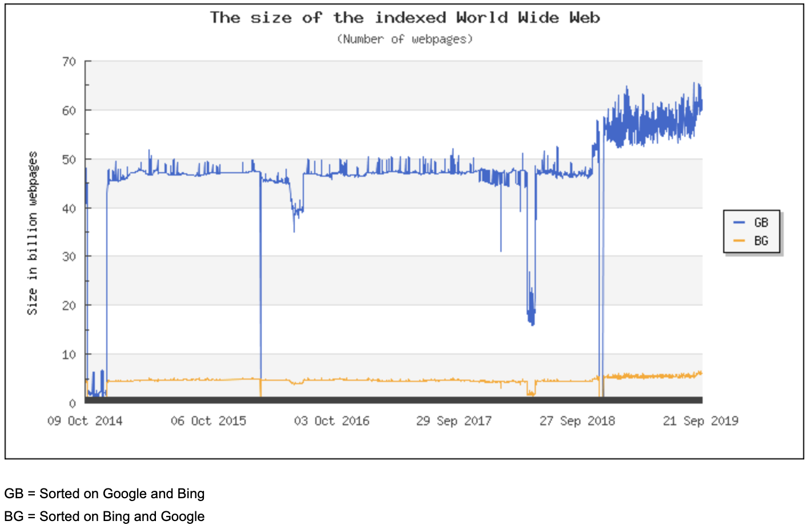
How big is the internet?
The Indexed Web contains at least 6.08 billion pages (Tuesday, 24 September, 2019).
# of servers that google has (as of 2017): >1 million
Population of USA: 329 million
Population of Earth: 7.7 Billion people
Xref: https://www.worldwidewebsize.com
Notes:
Sending a message over the internet is a lot like sending a message through the mail...if every letter we sent required thousands of envelopes!
Every message we send through the internet gets chopped up and each piece is wrapped in its own version of an envelope. We call those "packets." Packets are specially formed chunks of information that are able to easily flow through any of the internet's channels.
Sometimes, a few of those packets will get lost, because the internet is a crazy place. In that case, the packets need to be resent, and the whole message has to get put on hold until they arrive.

Slide 8
Internet Minute image credit: https://www.visualcapitalist.com/what-happens-in-an-internet-minute-in-2019/
Notes:
Internet Minute image credit: https://www.visualcapitalist.com/what-happens-in-an-internet-minute-in-2019/

Slide 9
THINK SAFETY!
Is the internet a public place or a private place?
ALWAYS consider it to be public.
NEVER put anything on the internet that you would not want a stranger to see!
Notes:
ALWAYS consider the internet to be PUBLIC: Truthfully, many people think it can be both, but it should be viewed as a public space no matter what settings you think you've mastered.

Slide 10
Ways we use the internet
What are some ways that we use the internet?
Web Browsing
Email
Instant Messaging
Video Conferencing
Listening to Music
Games
Today we cover Internet Basics, DNS, and Web Browsing..

Slide 11
How do Web Browsers Work?
Let's say that I want to look at the webpage for Fairhill Elementary School
How does the browser know where to go?
What happens when we request a page?
What are some ingredients of a web page?
Notes:
Sending a message over the internet is a lot like sending a message through the mail...if every letter we sent required thousands of envelopes!
Every message we send through the internet gets chopped up and each piece is wrapped in its own version of an envelope. We call those "packets." Packets are specially formed chunks of information that are able to easily flow through any of the internet's channels.
Sometimes, a few of those packets will get lost, because the internet is a crazy place. In that case, the packets need to be resent, and the whole message has to get put on hold until they arrive.

Slide 12
Activity: How does the Internet Work?
Class will mimic flowing through the internet, while learning about connections, URLs, IP Addresses, and the DNS.
Learning more about the internet will help students develop a better understanding of its endless possibilities
"Unplugged - The Internet" (3:11 video)
https://youtu.be/mFOUbqYv1Sc

Slide 13
Web Browsing
Here's what happens when you browse to a website
You enter a URL (website address)
Your computer 'resolves' it (next slide)
Your computer makes a connection
Your computer asks for a web page
The server returns the web page
Your computer asks for the OTHER info on that web page
You finally get a full page to view!

Slide 14
COMPUTERS NEED NUMBERS!
Web browsing to https://fairhilles.fcps.edu/
Computers don't "think" with NAMES, they think in numbers.
Fairhilles.fcps.edu = a name.
The computer needs a way to translate (or "resolve") the NAME into a number
This is done via a Domain Name Server

Slide 15
Where's THE phonebook?
Each computer needs one (or more) DNS hosts to use the internet.
This works like a phonebook that converts names into numbers.
Some names have more than one number!
I need three people to volunteer as our Domain Name Servers (DNS)
DNS1
DNS2
DNS3
Notes:
Instructor note:
PREP:
DNS1: has addresses for fairhilles.fcps.edu : 23.185.0.3
addtocalendar.com
DNS2: www.fcps.edu
translate.googleapis.com
DNS3: www.gstatic.com
fonts.gstatic.com

Slide 16
Where's The Fairhill Server?
Let's start by going to https://fairhilles.fcps.edu
Computer
go DNS1 and ask for fairhilles.fcps.edu
Not there! go DNS2 and ask for fairhilles.fcps.edu
Not there! go DNS3 and ask for fairhilles.fcps.edu
FOUND IT! Come back!
DNS1
DNS2
DNS3
Notes:
Instructor note:
PREP:
DNS1: has addresses for fairhilles.fcps.edu : 23.185.0.3
addtocalendar.com
DNS2: www.fcps.edu
translate.googleapis.com
DNS3: www.gstatic.com
fonts.gstatic.com

Slide 17
But There's MORE!
But Fairhill Elementary School's web page loads from OTHER websites!
Computer
Go to DNS1 and ask for gstatic.com
Not there! Go to DNS2 and ask for gstatic.com
FOUND IT! Come back!
DNS1
DNS2
DNS3
Notes:
Instructor note:
PREP:
DNS1: has addresses for fairhilles.fcps.edu : 23.185.0.3
addtocalendar.com
DNS2: www.fcps.edu
translate.googleapis.com
DNS3: www.gstatic.com
fonts.gstatic.com

Slide 18
And STILL more..
It also loads some stuff for Fairfax County Elementary School District!
Computer
Go to DNS1 and ask for www.fcps.edu
FOUND IT! Come back!
DNS1
DNS2
DNS3
Notes:
Instructor note:
PREP:
DNS1: has addresses for fairhilles.fcps.edu : 23.185.0.3
addtocalendar.com
DNS2: www.fcps.edu
translate.googleapis.com
DNS3: www.gstatic.com
fonts.gstatic.com

Slide 19
That's the "big picture"
In the video, it talked about "packets" of information going back and forth.
What is INSIDE these packets?
How big are they?

Slide 20
But What's "in" a page?
A Webpage has LOTS of stuff in it!
HTML : "code" that says how to show stuff
CSS : style – what colours to use
Images : cool graphics to make things interesting!
JavaScript : dynamic actions
Sounds (sometimes) on web pages
Advertising.. ☹

Slide 21
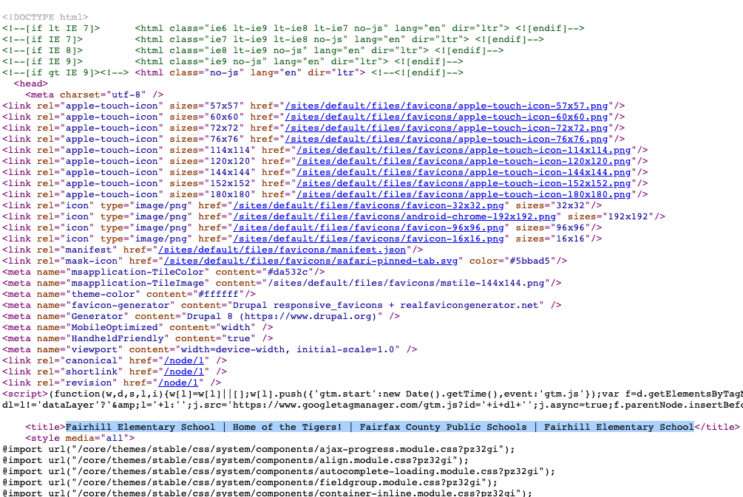
Example of HTML

Slide 22
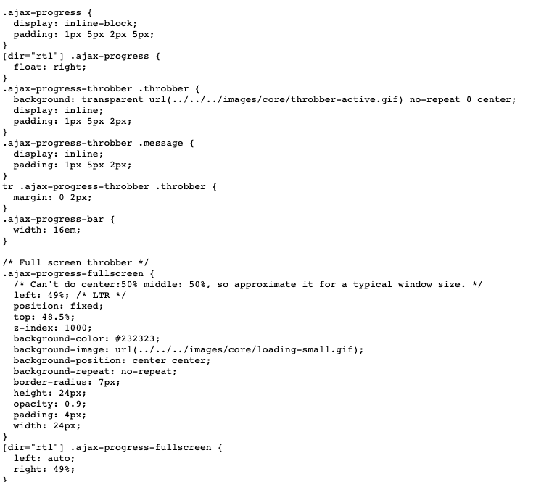
Example of CSS

Slide 23
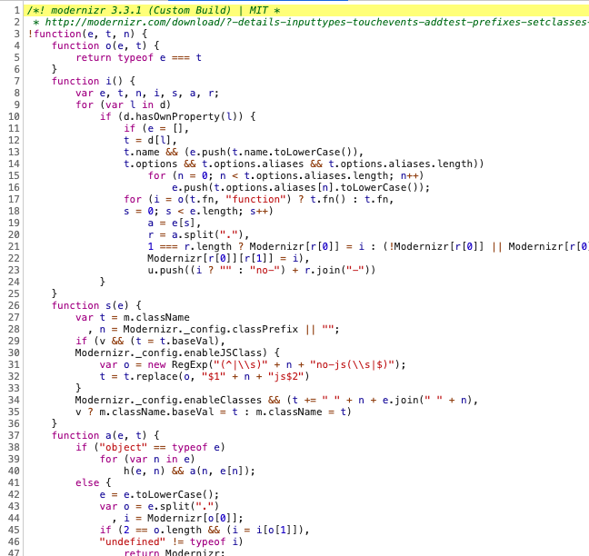
Example of JavaScript

Slide 24
How do we go faster?
Imagine a racecar pulling into the pit for tire changes and gas.
How many people usually help?
The answer is FIVE.
Crew Chief, Car Chief, Jackperson, 2 x Tire Changers
PS: The "tools" on the internet faster now too!
https://en.wikipedia.org/wiki/Pit_stop
Notes:
Browser has 'cached' the DNS entries for the first 3 sites
The first pit crews had to use manual wrenches, and NOW they have air-powered wrenches

Slide 25
Computers: Threads
Computers don't just have one "task" running a time, they have multiple "threads".
We need 6 different volunteers to be browser threads.
And 3 different volunteers to be DNS servers.
And we're going to pretend to be the browser getting some stuff for this page.
Our computer 'remembers' these
Fairhilles.fcps.edu
Gstatic.com
www.fcps.edu
But THESE ones are new!
Translate.google.com
addtocalendar.com
www.googletagmanager.com
Notes:
Browser has 'cached' the DNS entries for the first 3 sites

Slide 26
Computers: Threads
The computer browser threads have to
Find the server address (go to 1+ DNS first!)
Go to the web server
Come back with the data
Fairhilles.fcps.edu
Gstatic.com
www.fcps.edu
Translate.google.com
addtocalendar.com
www.googletagmanager.com
Notes:
This is going to be fairly ambitious!!!
3 students to be DNS servers
6 students to be computer 'threads' to go fetch information

Slide 27
Sounds complicated?
Let's think about what we just did.
What if we did not use computer threads?
Have you ever picked up leaves in your back yard?
Did you pick up one leaf at a time?
Did you work all by yourself?
Computers are doing more than we just did!
Notes:
Make sure that the students understand the point of the exercise

Slide 28
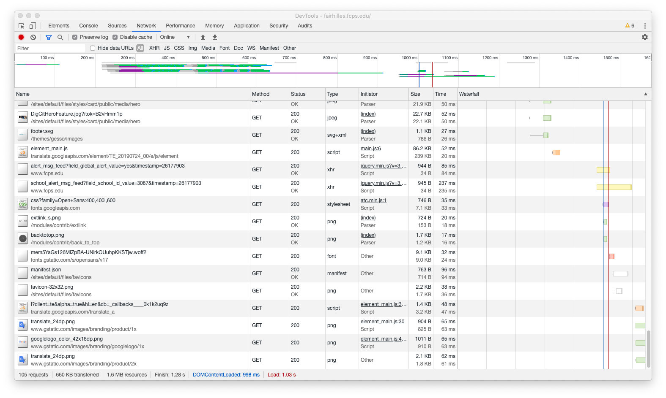
Lots of things Load!!
105 different things have to load for this page to show!!!!!!!
660 KB, or the equivalent of 165 pages, if it were printed out
And it does this all in a mere 1.03 seconds!!
Threads are the secret…
Notes:
Rule of thumb is that one page of TEXT is about 4k. So 660KB is about 165 pages, if it were all printed out!

Slide 29
Ever-Changing
The internet is continually changing, based on availability of servers.
What would happen if there was only one highway to get from here to California?
Notes:
For a much more detailed treatment of this, you can read at http://www.enterprisenetworkingplanet.com/netsp/article.php/3615896/Networking-101-Understanding-BGP-Routing.htm
Highway map credit: https://www.pitstopsforkids.com/wp-content/uploads/2009/04/interstate-map21.jpg
Network map credit: http://freeciscolab.com/wp-content/uploads/2010/12/BGP-RR-300x231.jpg

Slide 30
Ever make a mistake?
Has anybody ever had mail delivered to their house that was meant for somebody else?
Ever get mail returned because you didn't use enough postage?
These things happen on the internet too!
Notes:
For a much more detailed treatment of this, you can read at http://www.enterprisenetworkingplanet.com/netsp/article.php/3615896/Networking-101-Understanding-BGP-Routing.htm
Highway map credit: https://www.pitstopsforkids.com/wp-content/uploads/2009/04/interstate-map21.jpg
Network map credit: http://freeciscolab.com/wp-content/uploads/2010/12/BGP-RR-300x231.jpg

Slide 31
Not all the same
The computers on the internet aren't all the same – some are slower than others, and some make mistakes and LOSE what you send them!
Let's watch 4 messages from a computer go out.
Are all messages taking the same path?
Which message goes fastest?
Which message is lost in space?
What happens?
Notes:
For a much more detailed treatment of this, you can read at http://www.enterprisenetworkingplanet.com/netsp/article.php/3615896/Networking-101-Understanding-BGP-Routing.htm
Highway map credit: https://www.pitstopsforkids.com/wp-content/uploads/2009/04/interstate-map21.jpg
Network map credit: http://freeciscolab.com/wp-content/uploads/2010/12/BGP-RR-300x231.jpg

Slide 32
Fault Tolerant
The Internet was BUILT with the idea of resilience.
If a message (a "packet") doesn't make it to where it's supposed to get to, it will try again!
How the Internet Works Video: (5:32 video)
https://www.youtube.com/watch?v=oj7A2YDgIWE

Slide 33
WRAP-UP
The Internet is FASCINATING!
Whenever you go to a website, there are a LOT of computers that help to bring that web page to you.
If a server breaks, should the internet go down?
If you have questions about today's topic, please bring them next week so that we can go over them!

Slide 34
NEXT WEEK….
Binary Numbers+
Algorithms
How does the Internet work?
Scratch – Animate your name ←
Scratch - Make it fly
Scratch - Create a virtual pet
Scratch - Conan the Librarian
Beyond Scratch (Python + Java)
Embedded Computers (Arduino)
Drones – introduction (part 1)
Drones –flight path (part 2)
SPECIAL PROJECT

Slide 35
Contacts
Contact names @ School
Courtney Korb : cbkorb@fcps.edu : Assistant Principal
Jessica Gannon : jlgannon@fcps.edu : Grade 6 Teacher
Margaret Albertson : mralbertson1@fcps.edu : Grade 6 Teacher
Stephen Giese : SWGiese@fcps.edu : Technology Specialist
RESET
Shaheen Khurana shaheen.khurana@gmail.com : RESET Program Specialist
Keith Osterhage keith_osterhage@msn.com : Executive Director of RESET
Sherri Kohr sherri.kohr@gmail.com : Classroom Skills Advisor
Notes:
Sherri Kohr : https://resetonline.org/resets-story/staff-board/

Slide 36
Keith Osterhage
Keith Osterhage is Executive Director of RESET. Keith brings more than three decades of experience in management and administration, consulting, program evaluation, policy development and implementation, as well as financial and regulatory compliance. He has held leading administrative positions at five universities, has developed programs for mentoring and training young professionals, and has led teams of 10 to 30 professional staff. Having managed over $1 billion in funding (grants, contracts, cooperative agreements) from government, industry and foundations for programs of research, training and technical assistance, he has also worked directly as a contractor/consultant for the National Institutes of Health, the Environmental Protection Agency and the Departments of Energy, Transportation and Education Departments. His nonprofit expertise has included leadership roles at US Legal Services Corporation, American Society for Engineering Education and now RESET. Keith has a Bachelor of Arts degree from Ohio Northern University and two graduate degrees from Ohio State University. He has also been a Graduate Fellow in Government (Georgetown University) and a Certified Research Administrator since 1993. He holds a Management Development Certificate from Harvard University and a Leadership Institute Certificate from Temple University

Slide 37
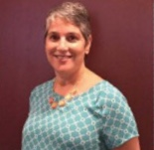
Sherri Kohr
Professor Sherri Kohr has worked with RESET since fall 2013. An adjunct professor at George Mason University, Ms. Kohr teaches future elementary school teachers how to present hands-on science in the classroom. As RESET’s Volunteer Education Skills Developer, Ms. Kohr provides training to RESET volunteers, observing them in the classroom and providing feedback and mentoring. She also participates in several RESET training seminars a year. Ms. Kohr has worked in the education field for 30 years. She also serves as the STEM Coordinator at a private school in Fairfax County where she develops STEM curriculum for Grades K–8 and plans a yearly STEM project for the entire school. In addition, she works with Fairfax county homeless youth at area shelters assisting them with homework and school related issues.

Slide 38
Shaheen Khurana
For more than 21 years, Shaheen Khurana worked on the design and implementation of mobile systems, GPS and disaster emergency telecommunications, including at CSRA Inc. in Arlington, Virginia, and at Sprint Nextel Corporation in Reston, Virginia. She now works with a number of local nonprofits and grassroots organizations focused on STEM/Computer Science outreach to underserved communities and girl scouts, promoting legislative actions for achieving menstrual equity in VA, campaigning to elect women candidates to public office and empowering victims of domestic abuse at the Women’s Center serving the metropolitan DC area. She holds bachelor’s degrees in mathematics and computer engineering from the University of Bombay, India, and a master’s degree in computer science from the University of Texas in Dallas. Ms. Khurana began working for RESET in 2017. She recruits and trains volunteers, develops school partnerships, provides social media content, compiles annual program data, and expands RESET’s role in providing hands-on programs for students in emerging fields, especially Computer Science. She also develops curriculum content to help volunteers design and improve classroom programs.

