Slide 1
Computer Science Program Overview
Bill Mitchell
RESET Program Volunteer Teacher

Slide 2
LESSON SUMMARY – The BIG Picture
Binary Numbers+ ✔️
Algorithms
How does the Internet work?
Scratch – Animate your name
Scratch - Make it fly
Scratch - Create a virtual pet
Scratch - Conan the Librarian
Beyond Scratch (Python + Java)
Embedded Computers (Arduino)
Drones – introduction (part 1)
Drones – flight path (part 2)
SPECIAL PROJECT
Notes:
Who has used a computer? Everyone right!
Who has used the Internet? What do you use it for? Searching, research, movies, games, youtube videos….
So we already know a lot about computers!!!
Today, we are going to do some coding activities to learn about how computers work and how we make it do what we want it to do!
Students will do hands-on activities to learn how computer programmers think through problems. They’ll learn to follow and create algorithms, break big problems down into smaller ones, and persist when faced with challenges.
Ask your students what they did to get ready for school this morning.
Write their answers on the board.
If possible, put numbers next to their responses to indicate the order that they happen.
If students give responses out of order, have them help you put them in some kind of logical order.
Point out places where order matters and places where it doesn't.
Introduce students to the idea that it is possible to create algorithms for the things that we do everyday.
Give them a couple of examples, such as making breakfast, brushing teeth, and planting a flower.

Slide 3
CS Lesson 2: ALGORITHMS
Real-life activities using algorithms.
Al-go-ri-thm is a list of steps that you can follow to finish a task
Pro-gram is an algorithm that has been coded into something that can be run by a machine
Students will make paper airplanes using an algorithm
Start building the skills to translate real world situations to online scenarios and vice versa
Build Paper Airplanes
Notes:
Directions: Cut out the steps for making a paper airplane from the worksheet provided in the resources.
Work together to choose the six correct steps from the nine total options.
Glue the six correct steps, in order, onto a separate piece of paper.
Trade the finished algorithm with another person or group and let them use it to make their plane!

Slide 4
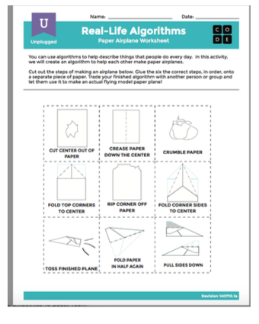
ACTIVITY: BUILD AIRPLANE
I'm going to show a series of 'building blocks'
Table by table, we're going to decide which block we will do, in order
At the end, one person from each table will give their algorithm.
Notes:
Directions: Cut out the steps for making a paper airplane from the worksheet provided in the resources.
Work together to choose the six correct steps from the nine total options.
Glue the six correct steps, in order, onto a separate piece of paper.
Trade the finished algorithm with another person or group and let them use it to make their plane!

Slide 5
ACTIVITY: BUILD AIRPLANE
Pick the letter of the next step
Write it down in your 'program'
When your plane is ready to fly, everybody at your table put your hands up!
Notes:
Directions: Cut out the steps for making a paper airplane from the worksheet provided in the resources.
Work together to choose the six correct steps from the nine total options.
Glue the six correct steps, in order, onto a separate piece of paper.
Trade the finished algorithm with another person or group and let them use it to make their plane!

Slide 6
ACTIVITY: BUILD AIRPLANE
Here's the order that we should have gotten..
1
B: Crease Paper
2
D: Fold Top Corners
3
F: Fold Corner Sides
4
H: Fold Paper In Half
5
I: Pull Sides Down
6
G: TOSS PLANE!
Notes:
Directions: Cut out the steps for making a paper airplane from the worksheet provided in the resources.
Work together to choose the six correct steps from the nine total options.
Glue the six correct steps, in order, onto a separate piece of paper.
Trade the finished algorithm with another person or group and let them use it to make their plane!

Slide 7
ACTIVITY: TEACHER ROBOT
This next activity is called "Teacher Robot"
To explain it, we're going to watch the first part of a short video:
https://www.youtube.com/watch?v=vBUtejDNvrs
The idea here is that I'm going to be your (dumb!) computer and you're going to program me to accomplish this task
Notes:
Directions: Cut out the steps for making a paper airplane from the worksheet provided in the resources.
Work together to choose the six correct steps from the nine total options.
Glue the six correct steps, in order, onto a separate piece of paper.
Trade the finished algorithm with another person or group and let them use it to make their plane!

Slide 8
ACTIVITY: TEACHER ROBOT
Robot Commands:
Move one square right
Move one square left
Move one square up
Move one square down
Fill square with colour
Let's get coding!!!
START
Notes:
Directions: Cut out the steps for making a paper airplane from the worksheet provided in the resources.
Work together to choose the six correct steps from the nine total options.
Glue the six correct steps, in order, onto a separate piece of paper.
Trade the finished algorithm with another person or group and let them use it to make their plane!

Slide 9
DISCUSS: TEACHER ROBOT
Did you notice anything about the commands we did?
Was there an order that seemed to repeat itself over and over?
Wouldn't it be nice if we could do it in … LOOP?
Notes:
Directions: Cut out the steps for making a paper airplane from the worksheet provided in the resources.
Work together to choose the six correct steps from the nine total options.
Glue the six correct steps, in order, onto a separate piece of paper.
Trade the finished algorithm with another person or group and let them use it to make their plane!

Slide 10
REPEAT.. REPEAT.. REPEAT..
Computers don't mind repeating themselves.
They never get bored
They never get bored
They never get bored
They never get bored
They never get bored
(We do!)
Notes:
Directions: Cut out the steps for making a paper airplane from the worksheet provided in the resources.
Work together to choose the six correct steps from the nine total options.
Glue the six correct steps, in order, onto a separate piece of paper.
Trade the finished algorithm with another person or group and let them use it to make their plane!

Slide 11
COMPUTER TIME
Here's a great exercise to practice algorithms and also refresh on how to use Scratch
Nested Loops in Maze (on code.org)
No login required
Has an environment like scratch
Self-paced
Short link:
https://bit.ly/2ncCzcp
Notes:
Directions: Cut out the steps for making a paper airplane from the worksheet provided in the resources.
Work together to choose the six correct steps from the nine total options.
Glue the six correct steps, in order, onto a separate piece of paper.
Trade the finished algorithm with another person or group and let them use it to make their plane!

Slide 12
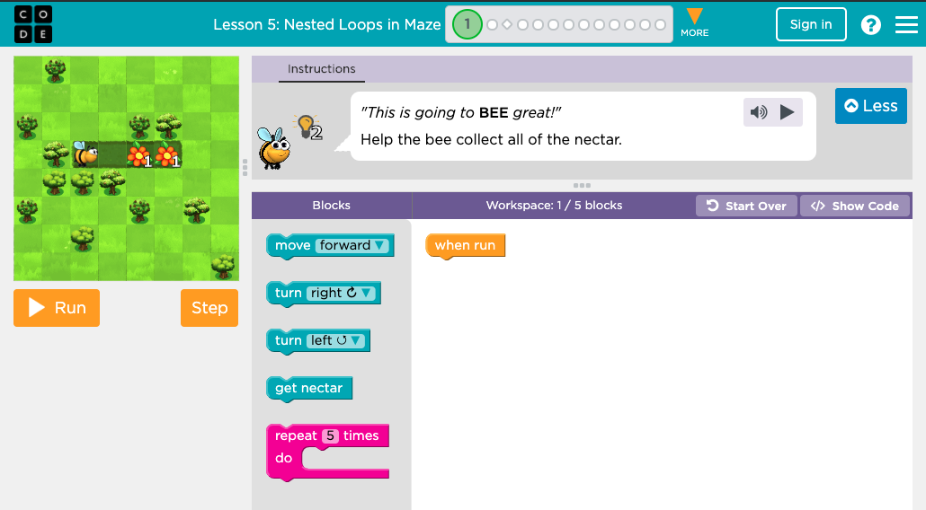
https://bit.ly/2ncCzcp
Notes:
Directions: Cut out the steps for making a paper airplane from the worksheet provided in the resources.
Work together to choose the six correct steps from the nine total options.
Glue the six correct steps, in order, onto a separate piece of paper.
Trade the finished algorithm with another person or group and let them use it to make their plane!

Slide 13
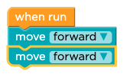
https://bit.ly/2ncCzcp
First you DRAG a "move forward" block underneath the 'when run'..
Then drag another one..
Then you want to 'get nectar'…
Notes:
Directions: Cut out the steps for making a paper airplane from the worksheet provided in the resources.
Work together to choose the six correct steps from the nine total options.
Glue the six correct steps, in order, onto a separate piece of paper.
Trade the finished algorithm with another person or group and let them use it to make their plane!

Slide 14
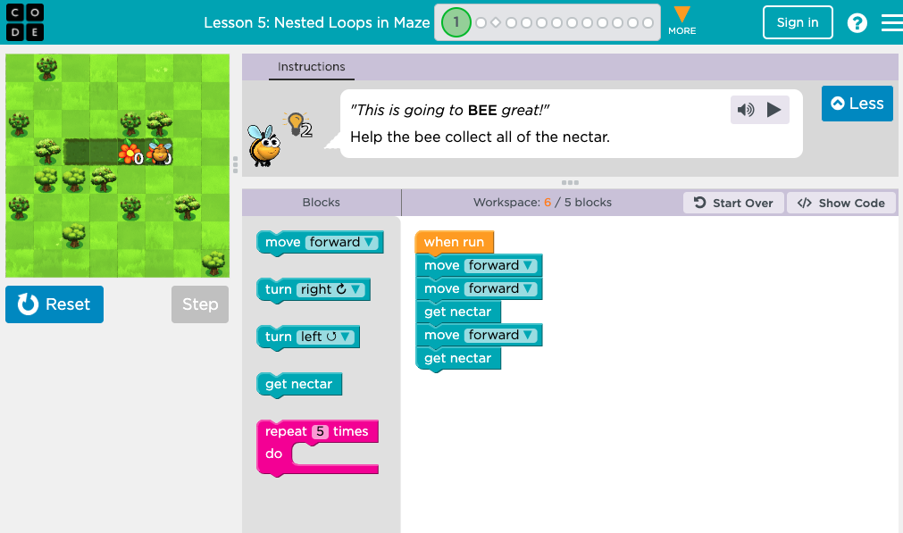
https://bit.ly/2ncCzcp
Notes:
Directions: Cut out the steps for making a paper airplane from the worksheet provided in the resources.
Work together to choose the six correct steps from the nine total options.
Glue the six correct steps, in order, onto a separate piece of paper.
Trade the finished algorithm with another person or group and let them use it to make their plane!

Slide 15
https://bit.ly/2ncCzcp
Done once here
And again here!
Wouldn't it be better if we could just … REPEAT this? (hint hint)
Notes:
Directions: Cut out the steps for making a paper airplane from the worksheet provided in the resources.
Work together to choose the six correct steps from the nine total options.
Glue the six correct steps, in order, onto a separate piece of paper.
Trade the finished algorithm with another person or group and let them use it to make their plane!

Slide 16
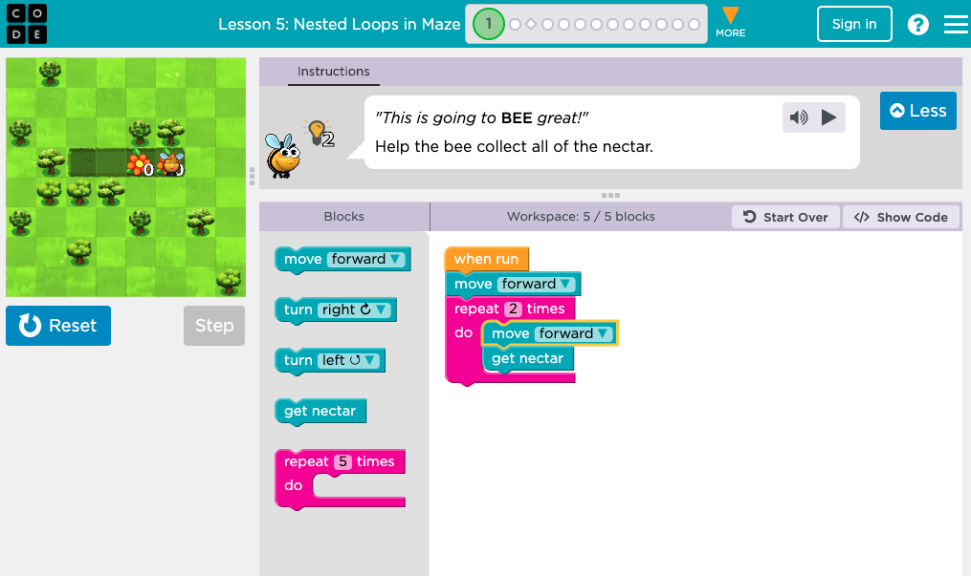
https://bit.ly/2ncCzcp
Notes:
Directions: Cut out the steps for making a paper airplane from the worksheet provided in the resources.
Work together to choose the six correct steps from the nine total options.
Glue the six correct steps, in order, onto a separate piece of paper.
Trade the finished algorithm with another person or group and let them use it to make their plane!

Slide 17
https://bit.ly/2ncCzcp
Notes:
Directions: Cut out the steps for making a paper airplane from the worksheet provided in the resources.
Work together to choose the six correct steps from the nine total options.
Glue the six correct steps, in order, onto a separate piece of paper.
Trade the finished algorithm with another person or group and let them use it to make their plane!

Slide 18
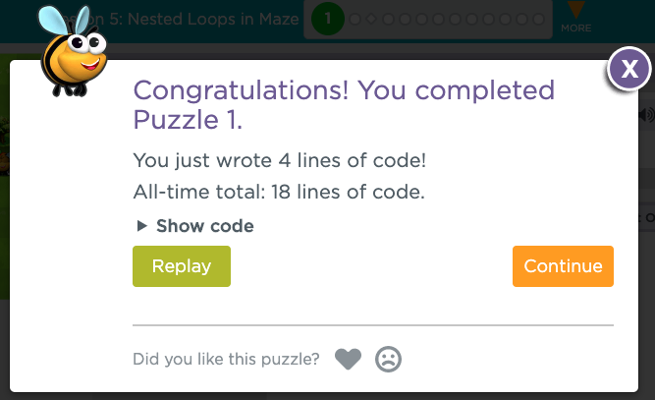
https://bit.ly/2ncCzcp
Notes:
Directions: Cut out the steps for making a paper airplane from the worksheet provided in the resources.
Work together to choose the six correct steps from the nine total options.
Glue the six correct steps, in order, onto a separate piece of paper.
Trade the finished algorithm with another person or group and let them use it to make their plane!

Slide 19
KEEP ON BEE'ING AWESOME!
Now that you have the hang of it, just keep going!
You should have time to go through several more lessons before the end of the class.
When we have just 5 minutes left, I'll do a wrap up and discuss what we are doing next week.
Notes:
Directions: Cut out the steps for making a paper airplane from the worksheet provided in the resources.
Work together to choose the six correct steps from the nine total options.
Glue the six correct steps, in order, onto a separate piece of paper.
Trade the finished algorithm with another person or group and let them use it to make their plane!

Slide 20
WRAP-UP
Algorithms are really cool, they are the 'secret tricks' that are used to solve problems in efficient ways!
If you have questions about today's topic, please bring them next week so that we can go over them!

Slide 21
NEXT WEEK….
Binary Numbers+
Algorithms
How does the Internet work? ←
Scratch – Animate your name
Scratch - Make it fly
Scratch - Create a virtual pet
Scratch - Conan the Librarian
Beyond Scratch (Python + Java)
Embedded Computers (Arduino)
Drones – introduction (part 1)
Drones –flight path (part 2)
SPECIAL PROJECT

