Slide 1

Computer Science Program Overview
Shaheen Khurana
RESET Program Director

Slide 2
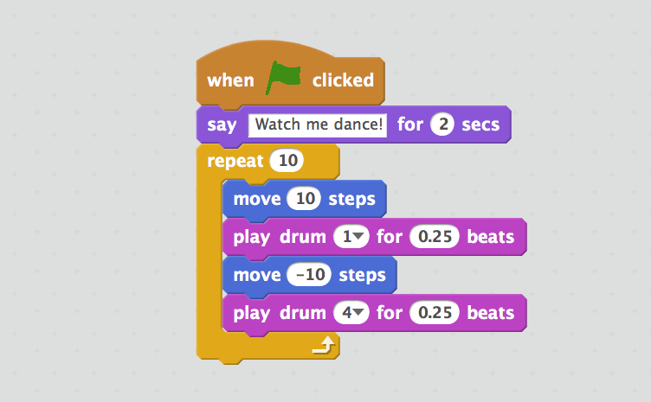
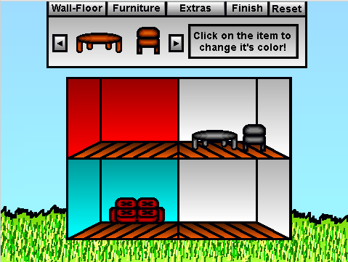

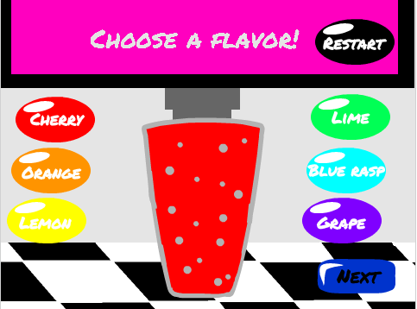
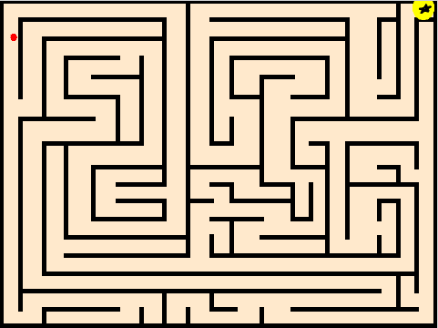
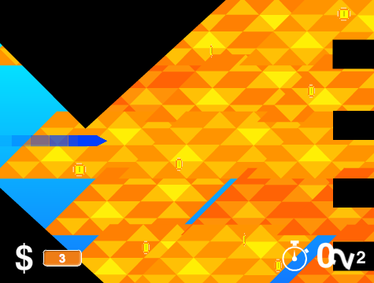
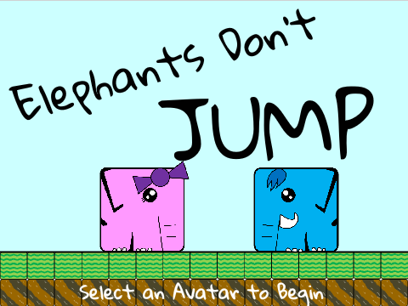
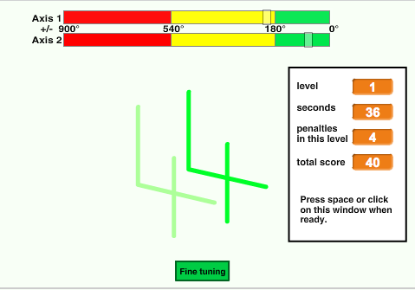
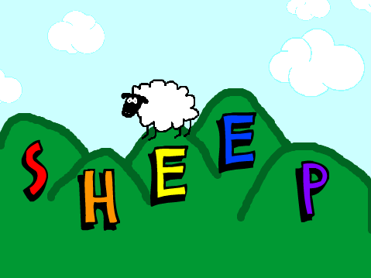
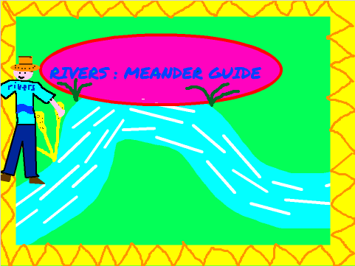
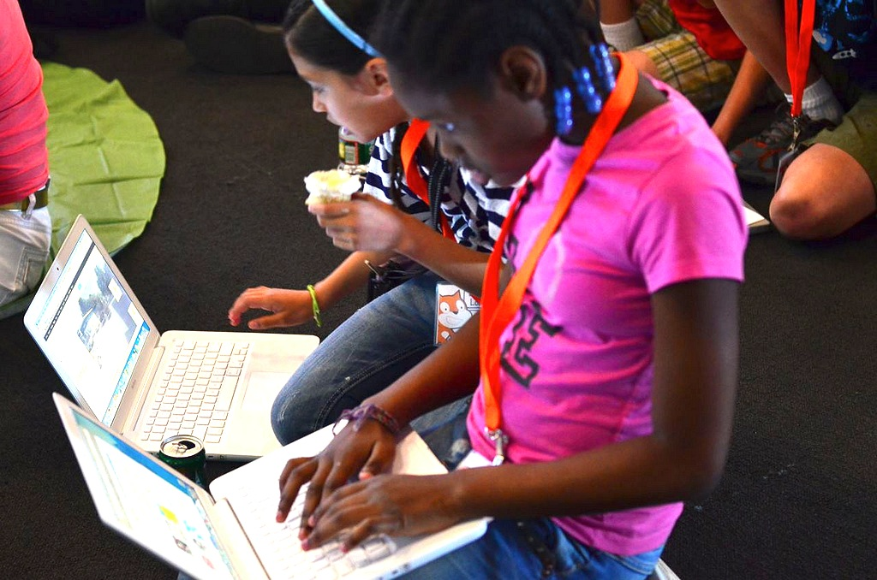

CS Program Goals
CS Unplugged
  Teach Computer Science through engaging games and lots of running around
  Introduces computational thinking i.e. fundamental principles on which computers and networks operate
Hands-on Programming using SCRATCH
  MIT developed programming language for school-aged kids
  Program your own interactive stories, games, and animations
Computer Science Matters video
Notes:
CS Unplugged – Computer Science without a computer
Computational Thinking - introduce students to Computational Thinking through concepts such as binary numbers, algorithms etc. separated from the distractions and technical details of having to use computers.

Slide 3
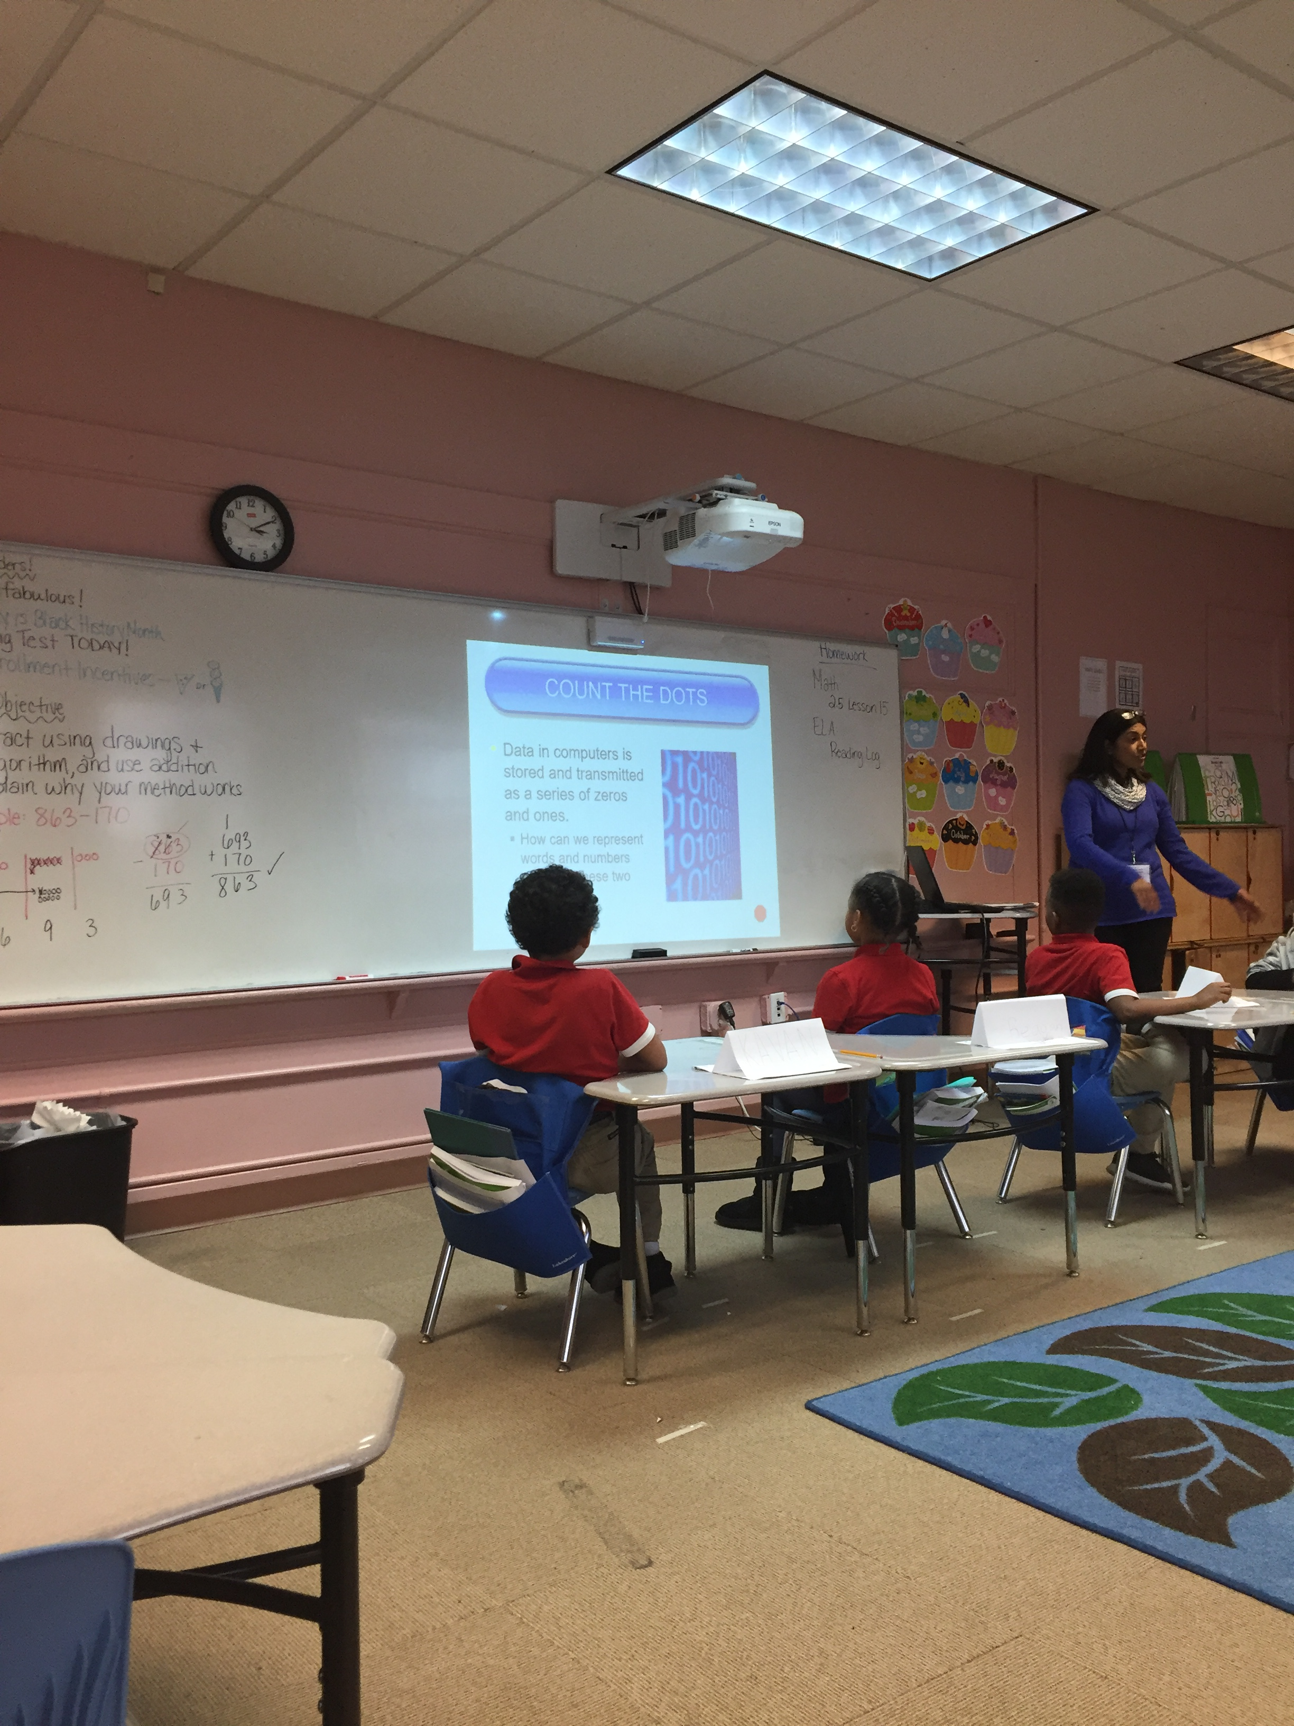
Harmony DCPS Lesson PLAN
Binary Number System
  Count the Dots
Algorithms & Programs
  Build Paper Airplanes
The Internet
  Pretend to flow through the internet, all the while learning about connections, URLs, IP Addresses, and the DNS.
SCRATCH programming exercises
  Animate your Name, Make It fly, Virtual Pet
Notes:
6 Lessons – 3 taught through games and activities, 3 hands-on programming using SCRATCH
Audience: 2nd grade students at Harmony DC Public Charter School

Slide 4
Girl scouts Program
CS Teen Training
  Two 2-hour sessions with 20 teens each
  Train the trainers
Larger Brownie/Junior 2nd-6th grade event
  3-4 stations with CS Activities
  Teen Girl Scouts teach the younger girls scouts
Everyone receives a “Think Like A Programmer” badge and a RESET Girl Scout badge
Notes:
6 Lessons – 3 taught through games and activities, 3 hands-on programming using SCRATCH
Audience: 2nd grade students at Harmony DC Public Charter School

Slide 5
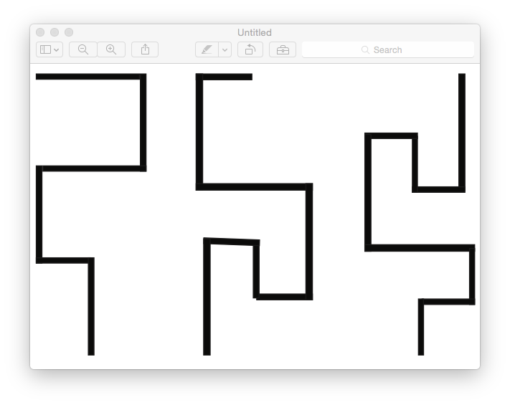
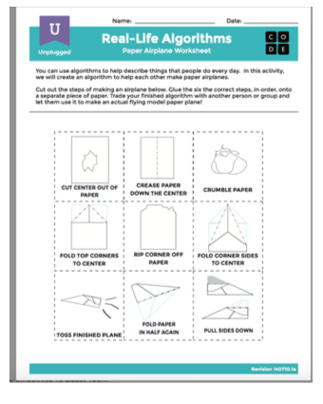
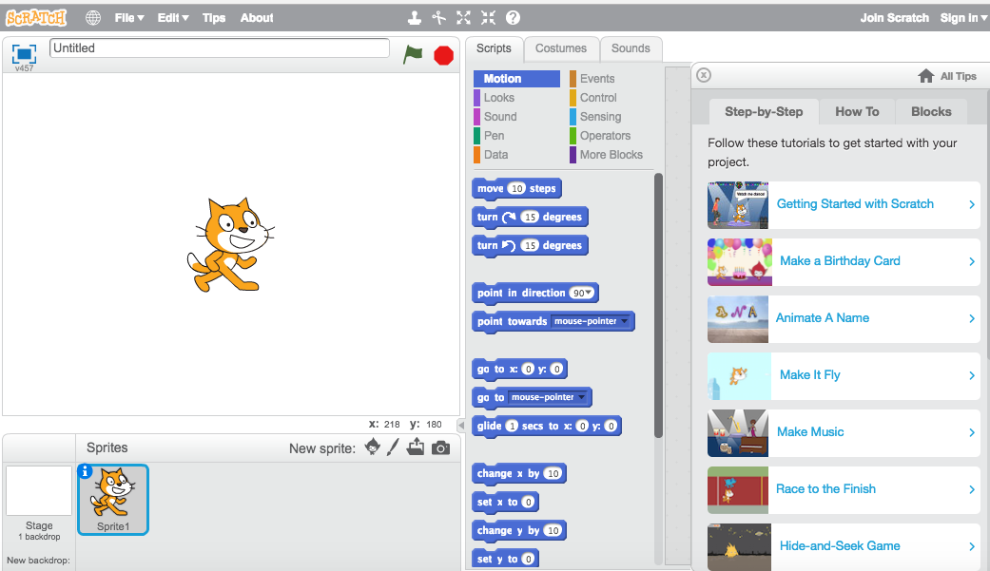
Girl scouts – “Think Like A
Programmer” Badge
Algorithms & Programs
  Walk the Line game
  Build Paper Airplanes
SCRATCH programming exercises
  Animate Your Name, Make It fly, Virtual Pet
Making a personal connection to CS
  What can you teach?
  Personal Innovations
  Prototyping
Notes:
6 Lessons – 3 taught through games and activities, 3 hands-on programming using SCRATCH
Audience: 2nd grade students at Harmony DC Public Charter School

Slide 6
Girl scouts FlYer– Teen Training
Notes:
6 Lessons – 3 taught through games and activities, 3 hands-on programming using SCRATCH

Slide 7
Girl scouts FlYer
– Brownie/Juniors CS Event
Notes:
6 Lessons – 3 taught through games and activities, 3 hands-on programming using SCRATCH
Audience: 2nd grade students at Harmony DC Public Charter School

Slide 8
Related Standards of Learning
All lessons align to all relevant computer science standards, as well as to the ISTE standards. They additionally reinforce concepts and skills taught in other subject areas by integrating national Math, English Language Arts and Science standards.
CSTA K-12 Computer Science Standards
  CPP - Computing Practice & Programming
  CT - Computational Thinking
ISTE Standards for Students
  1 - Creativity and Innovation
  2 - Communication and Collaboration
  4 - Critical Thinking, Problem Solving, and Decision Making
  6 - Technology Operations and Concepts
Common Core English Language Arts Standards
  L – Language
  SL - Speaking & Listening
Common Core Math Standards
  G – Geometry
  MP - Math Practices
Next Generation Science Standards (NGSS)
  Computer Science principles can be found in the NGSS. Science and Engineering Practices include developing and using models, and using mathematics and computational thinking.
Notes:
The CSTA K-12 Computer Science Standards are created and maintained by members of the Computer Science Teachers Association (CSTA). The CSTA K-12 Computer Science Standards are focused on learning outcomes specific to the discipline of computer science.
ISTE-International Society for Technology in Education
Creativity and innovation
Communication and collaboration
Research and information fluency
Critical thinking, problem solving,
and decision making
5. Digital citizenship
6. Technology operations and concepts
All lessons align to all relevant computer science standards, as well as to the ISTE standards. They additionally reinforce concepts and skills taught in other subject areas by integrating national Math, English Language Arts, and Science standards. Read more about our curriculum philosophy.
Right now many states are working toward the Next Generation Science Standards (NGSS) vision of STEM teaching and learning (and many more embracing the NGSS foundational practices outlined in the Framework for K–12 Science Education). Computer Science principles can be found in the NGSS. Science and Engineering Practices include developing and using models, and using mathematics and computational thinking. In the integrated STEM classroom, using the principles of NGSS, educators are working to seek out real-world, relevant, authentic problems that would be of interest to students and ask them to apply computational thinking to solve the problem using data analysis, visualization, seeking patterns, and computation.
The Common Core is a set of high-quality academic standards in mathematics and English language arts/literacy (ELA).

Slide 9
HOW Do we Put Computers to
Work?
Al-go-ri-thm is a list of steps that you can follow to finish a task
Pro-gram is an algorithm that has been coded into something that can be run by a machine
What is Computer Science?
Computer Science Matters video
Notes:
Who has used a computer? Everyone right!
Who has used the Internet? What do you use it for? Searching, research, movies, games, youtube videos….
So we already know a lot about computers!!!
Today, we are going to do some coding activities to learn about how computers work and how we make it do what we want it to do!
Students will do hands-on activities to learn how computer programmers think through problems. They’ll learn to follow and create algorithms, break big problems down into smaller ones, and persist when faced with challenges.
Ask your students what they did to get ready for school this morning.
Write their answers on the board.
If possible, put numbers next to their responses to indicate the order that they happen.
If students give responses out of order, have them help you put them in some kind of logical order.
Point out places where order matters and places where it doesn't.
Introduce students to the idea that it is possible to create algorithms for the things that we do everyday.
Give them a couple of examples, such as making breakfast, brushing teeth, and planting a flower.

Slide 10
HOW Do we Put Computers to
Work?
Bug – Part of a program that does not work correctly
Debugging- Finding and fixing problems in an algorithm or program
What is Computer Science?
Computer Science Matters video
Notes:
Who has used a computer? Everyone right!
Who has used the Internet? What do you use it for? Searching, research, movies, games, youtube videos….
So we already know a lot about computers!!!
Today, we are going to do some coding activities to learn about how computers work and how we make it do what we want it to do!
Students will do hands-on activities to learn how computer programmers think through problems. They’ll learn to follow and create algorithms, break big problems down into smaller ones, and persist when faced with challenges.
Ask your students what they did to get ready for school this morning.
Write their answers on the board.
If possible, put numbers next to their responses to indicate the order that they happen.
If students give responses out of order, have them help you put them in some kind of logical order.
Point out places where order matters and places where it doesn't.
Introduce students to the idea that it is possible to create algorithms for the things that we do everyday.
Give them a couple of examples, such as making breakfast, brushing teeth, and planting a flower.

Slide 11

CS Lesson 1: Binary Numbers
Data in computers is stored and transmitted as a series of zeros and ones.
  How can we represent words and numbers using just these two symbols?
  What is the difference between data and information?
What is Computer Science?
Notes:
Develop Computational thinking (fundamental principles on which computers and networks operate)
How can we store information in computers?
What is the difference between data and information?
How can numbers, letters, words and pictures be converted into zeros and ones?
Algorithms and how they are used in Sorting networks to speed up computers
How can we store information in computers?
The word computer comes from the Latin computare, which means to calculate or add together, but computers today are more than just giant calculators. They can be a library, help us to write, find information for us, play music and even show movies. So how do they store all this information? Believe it or not, the computer uses only two things: zero and one!
What is the difference between data and information?
Data is the raw material, the numbers that computers work with. A computer converts its data into information (words, numbers and pictures) that you and I can understand.
Let’s learn about binary numbers!

Slide 12

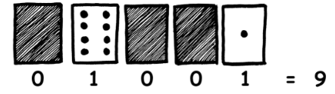
Activity: COUNT THE DOTS
Five students to hold the demonstration cards at the front of the class.
Display the cards so the following number of dots are showing: 9
Notes:
When a binary number card is not showing, it is represented by a zero. When it is showing, it is represented by a one. This is the binary number system (base 2).

Slide 13
ActiVITY: COUNT THE DOTS
Letters are represented in computers in binary also!
blank 0 00000₂
A 1 00001₂
B 2 00010₂
C 3 00011₂
...
Z 26 11010₂

Slide 14
ActiVITY: COUNT THE DOTS
blank 0
A 1
B 2
C 3
D 4
E 5
F 6
G 7
H 8
I 9
J 10
K 11
L 12
M 13
N 14
O 15
P 16
Q 17
R 18
S 19
T 20
U 21
V 22
W 23
X 24
Y 25
Z 26
01001
00011
00101
00000
00011
10010
00101
00001
01101
I
C
E
_
C
R
E
A
M

Slide 15
ActiVITY: PUT COMPUTERS TO WORK
Even though computers are fast, there is a limit to how quickly they can solve problems. Sorting networks is a strategy that computers use to sort random numbers into order.
Students are led into an activity to turn themselves into a simple sorting network where they compared the number cards they were holding and sorted themselves into ascending order.
Sorting Networks video
Notes:
Algorithms – Putting Computers to work
Computers operate by following a list of instructions set for them. These instructions enable them to sort, find and send information. To do these things as quickly as possible, you need good methods for finding things in large collections of data, and for sending information through networks.
An algorithm is a set of instructions for completing a task. The idea of an algorithm is central to computer science. Algorithms are how we get computers to solve problems. Some algorithms are faster than others, and many of the algorithms that have been discovered have made it possible to solve problems that previously took an infeasible length of time—for example, finding millions of digits in pi, or all pages that contain your name on the World-Wide Web, or finding out the best way to pack parcels into a container, or finding out whether or not very large (100-digit) numbers are prime.

Slide 16
CS Lesson 2: ALGORITHMS
Real-life activities using algorithms.
Al-go-ri-thm is a list of steps that you can follow to finish a task
Pro-gram is an algorithm that has been coded into something that can be run by a machine
Students will make paper airplanes using an algorithm
Start building the skills to translate real world situations to online scenarios and vice versa
Build Paper Airplanes
Notes:
Directions: Cut out the steps for making a paper airplane from the worksheet provided in the resources.
Work together to choose the six correct steps from the nine total options.
Glue the six correct steps, in order, onto a separate piece of paper.
Trade the finished algorithm with another person or group and let them use it to make their plane!

Slide 17
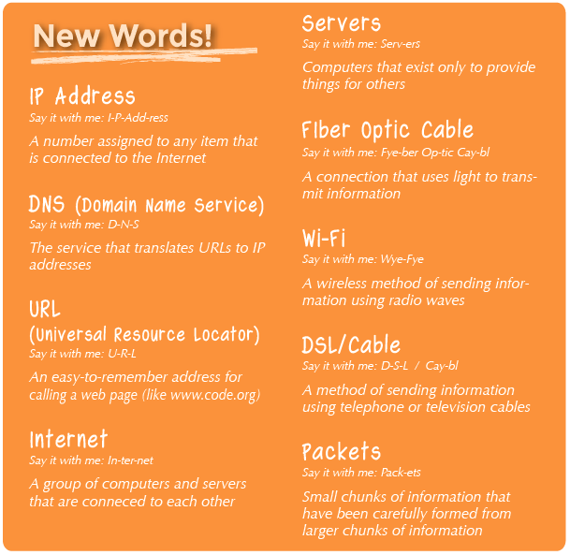
CS Lesson 3: How does the Internet Work?

Slide 18
Activity: How does the Internet Work?
Students will pretend to flow through the internet, all the while learning about connections, URLs, IP Addresses, and the DNS.
Learning more about the internet will help students develop a better understanding of its endless possibilities
Lesson Video:
https://youtu.be/mFOUbqYv1Sc
How the Internet Works Video: https://www.youtube.com/watch?v=oj7A2YDgIWE

Slide 19
Hands-ON Programming with SCRATCH
The ability to code computer programs is an important part of literacy in today’s society.
SCRATCH is a MIT developed programming language. When students learn to code in Scratch, they learn important strategies for solving problems, designing projects, and communicating ideas.
Scratch is designed especially for ages 8 to 16.
Notes:
Students need a computer or tablet with Internet connection.
Students need accounts for SCRATCH. Instructor needs Teacher account and student accounts can be established under Teacher account. Accounts can be obtained at SCRATCH.MIT.EDU

Slide 20
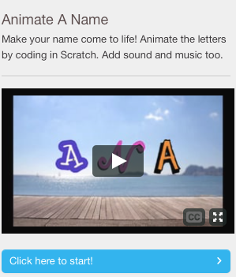
CS Lesson 4: SCRATCH – Animate your Name
Students animate the letters of their username, initials, or favorite word using sounds, color and motion.
Lesson plan: https://resources.scratch.mit.edu/www/guides/en/AnimateYourNameGuide.pdf
https://vimeo.com/144905435
Notes:
Students need a computer or tablet with Internet connection.
Students need accounts for SCRATCH. Instructor needs Teacher account and student accounts can be established under Teacher account. Accounts can be obtained at SCRATCH.MIT.EDU

Slide 21
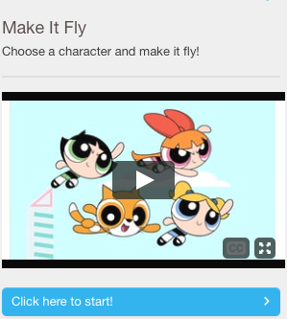
CS Lesson 5: Make it Fly!!
Choose any character and make it fly!
Video: vimeo.com/llk/fly
https://resources.scratch.mit.edu/www/guides/en/FlyGuide.pdf

Slide 22
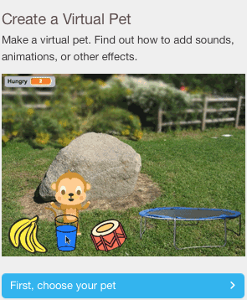
CS Lesson 6: Create a Virtual Pet
Make a virtual pet. Find out how to add sounds, animations, or other effects.
Lesson plan: https://resources.scratch.mit.edu/www/guides/en/PetGuide.pdf

Slide 23
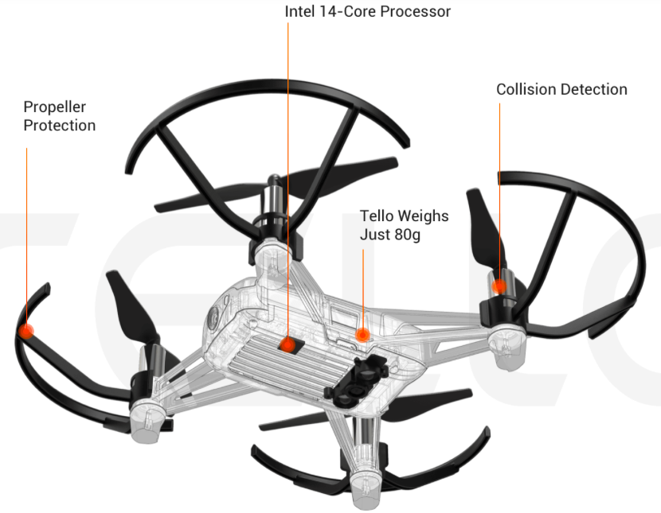
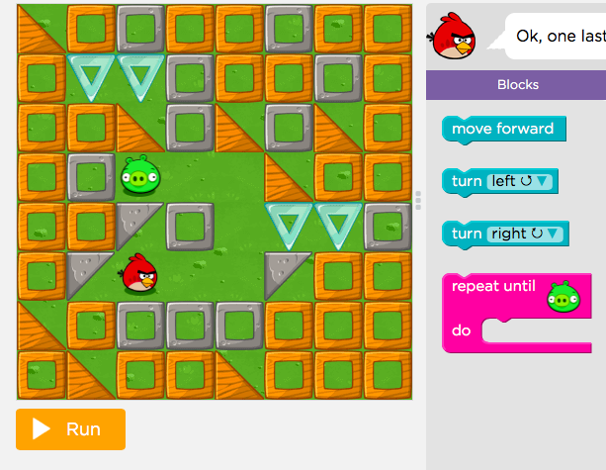
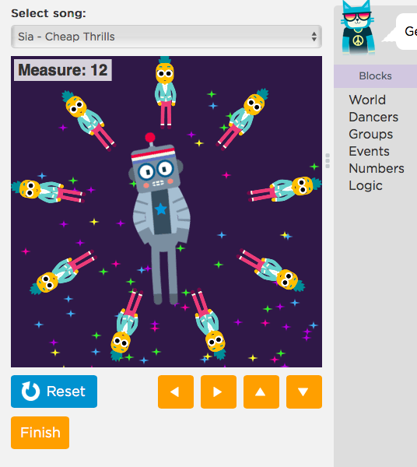
Harmony DCPS 5th Grade Lesson PLAN
Notes:
6 Lessons – 3 taught through games and activities, 3 hands-on programming using SCRATCH
Audience: 2nd grade students at Harmony DC Public Charter School

Slide 24
Hour of Code LessonS
Angry Birds at https://studio.code.org/hoc/1
Frozen – Code with Anna and Elsa https://studio.code.org/s/frozen/stage/1/puzzle/3
Notes:
Students need a computer or tablet with Internet connection.
Students need accounts for SCRATCH. Instructor needs Teacher account and student accounts can be established under Teacher account. Accounts can be obtained at SCRATCH.MIT.EDU

Slide 25
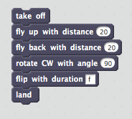
Technological INNOVATION
Innovation —a new or improved idea, device, product, etc. Recognizing a problem that needs to be solved, or recognizing something needs improving and then building a tool to solve it.
Example – Drones also known as UAVs (Unmanned Aerial Vehicles).
For Disaster Relief, sent in to assess extent of structural damage using aerial photography, delivering emergency supplies, etc. where manned flight is considered too risky or difficult.
Notes:
….is about recognizing a problem that needs to be solved, or recognizing something needs improving and then building a tool to solve it.
Disaster Relief- Send drones in to assess damage. Disaster In March 2011, a powerful earthquake caused a tsunami to hit Japan, resulting in severe damage to the Fukushima Daiichi nuclear plant. The damage led to a full-scale evacuation because of the amount of dangerous nuclear material that was released. Drones were deployed in the air and on the ground at the first possible instance to assess the extent of the destruction.
The area is largely inaccessible due to damaged roadways and bridges, but drone footage shows a startling bird's-eye glimpse of the destruction Michael caused when it made landfall near Mexico Beach
What are some other examples?? Everyday examples….making information more accessible, the Internet. Being able to communicate while traveling or while moving – the mobile/cell phone.
For you own area of interest:
1. Identify some way that technology is used with, or affects that thing
2. Can you make a suggestion for either: i) a way that technology might be improved to make it better, faster, easier to use ii) a creative or innovative new technology might help solve some problem within that area, or at least make better?
Be on the lookout, to be alert, for where and how computer science & technology affects or impacts the things you care about, the things you know a lot about. Whatever it is you want to do in your life, it’s pretty likely that technology affects it in some way, or that some technological innovation is called for.

Slide 26
BRIDGING Technology &
YOUR PaSSION
    Your PASSION!
Medicine & Sciences
Art & Design
Social Good and Animal Rescue
Music
Sports
Travel
Food
Books etc.
    TECHNOLOGIES that can help!
3D Printing
Large-Scale Simulations
Robotics & Automation
Computer Aided Designs (CAD)
Creative Software Packages
Virtual Reality (VR) & Augmented Reality (AR)
Notes:
Whatever your passion or interest is, computers and technology can help you….for example, if you are interested in art or music or sports, CAD and creative software packages will help you optimize your work.
Medical & Science
Online patient portal
Scheduling
View records
Online science courses
Research work
MUSIC
Online tutorials
Online music sheets
Creative software
GarageBand
And more …
LEISURe & FOOD
Online Reviews
Online Recipes
E-Books
More …
Social work & Animal Rescue
Online volunteer matching
Online adoptions
Online contributions
Petition, pledges
Donations
Get creative!
Which of the following best describes your interest or hobby? *
Check all that apply.
Art & Design
Music
Science & Technology
Sports
Food
Social Good & Animal Rescue
Travel
Other:
If you can, please describe your interest or hobby a bit more. For example, if you answered 'food', do you like cooking? Or baking or interested in nutrition? Or just like eating in general?
Can you identify some way that technology is used with, or affects your interests?
Can you make a suggestion for either: i) a way that technology might be improved to make it better, faster, easier to use ii) a creative or innovative new technology might help solve some problem within that area, or at least make better?

Slide 27
Interest/Hobby Survey
Which of the following best describes your interest or hobby? *
Check all that apply.
    Art & Design
    Music
    Science & Technology
    Sports
    Food
    Social Good & Animal Rescue
    Travel
    Other:
If you can, please describe your interest or hobby a bit more. For example, if you answered 'food', do you like cooking? Or baking or interested in nutrition? Or just like eating in general?
Can you identify some way that technology is used with, or affects your interests
Can you make a suggestion for either: i) a way that technology might be improved to make it better, faster, easier to use ii) a creative or innovative new technology might help solve some problem within that area, or at least make better?
Notes:
Whatever your passion or interest is, computers and technology can help you….for example, if you are interested in art or music or sports, CAD and creative software packages will help you optimize your work.
Medical & Science
Online patient portal
Scheduling
View records
Online science courses
Research work
MUSIC
Online tutorials
Online music sheets
Creative software
GarageBand
And more …
LEISURe & FOOD
Online Reviews
Online Recipes
E-Books
More …
Social work & Animal Rescue
Online volunteer matching
Online adoptions
Online contributions
Petition, pledges
Donations
Get creative!
Which of the following best describes your interest or hobby? *
Check all that apply.
Art & Design
Music
Science & Technology
Sports
Food
Social Good & Animal Rescue
Travel
Other:
If you can, please describe your interest or hobby a bit more. For example, if you answered 'food', do you like cooking? Or baking or interested in nutrition? Or just like eating in general?
Can you identify some way that technology is used with, or affects your interests?
Can you make a suggestion for either: i) a way that technology might be improved to make it better, faster, easier to use ii) a creative or innovative new technology might help solve some problem within that area, or at least make better?

Slide 28
Related Documents
Lesson Plans
  https://resetonline.org/learning-resources/sample-experiments/
  Under Computer Science & Math category
Reference Websites
  https://scratch.mit.edu/about
  https://resources.scratch.mit.edu/www/guides/en/AnimateYourNameGuide.pdf
  http://csunplugged.org/binary-numbers/.
  https://resources.scratch.mit.edu/www/guides/en/FlyGuide.pdf
  https://curriculum.code.org/csf/coursee/16/
  https://curriculum.code.org/csf/coursec/4/
  https://resources.scratch.mit.edu/www/guides/en/PetGuide.pdf

Slide 29
Be a Computer Scientist!
10100 01000 00001 01110 01011
11001 01111 10101
(THANK YOU!)

